Slide 1
Sentiment Analysis to predict stock price

Slide 2
Overview
Web scrap news articles by date
Data cleaning
Analyse the sentiment of the news articles
Web scrap stock prices by date
Correlation between change in sentiment vs change in stock prices
Predict stock price based on news articles

Slide 3
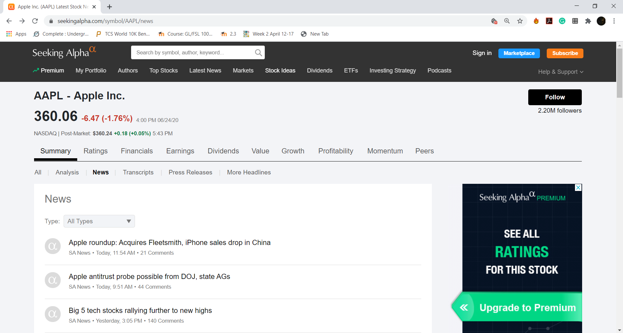
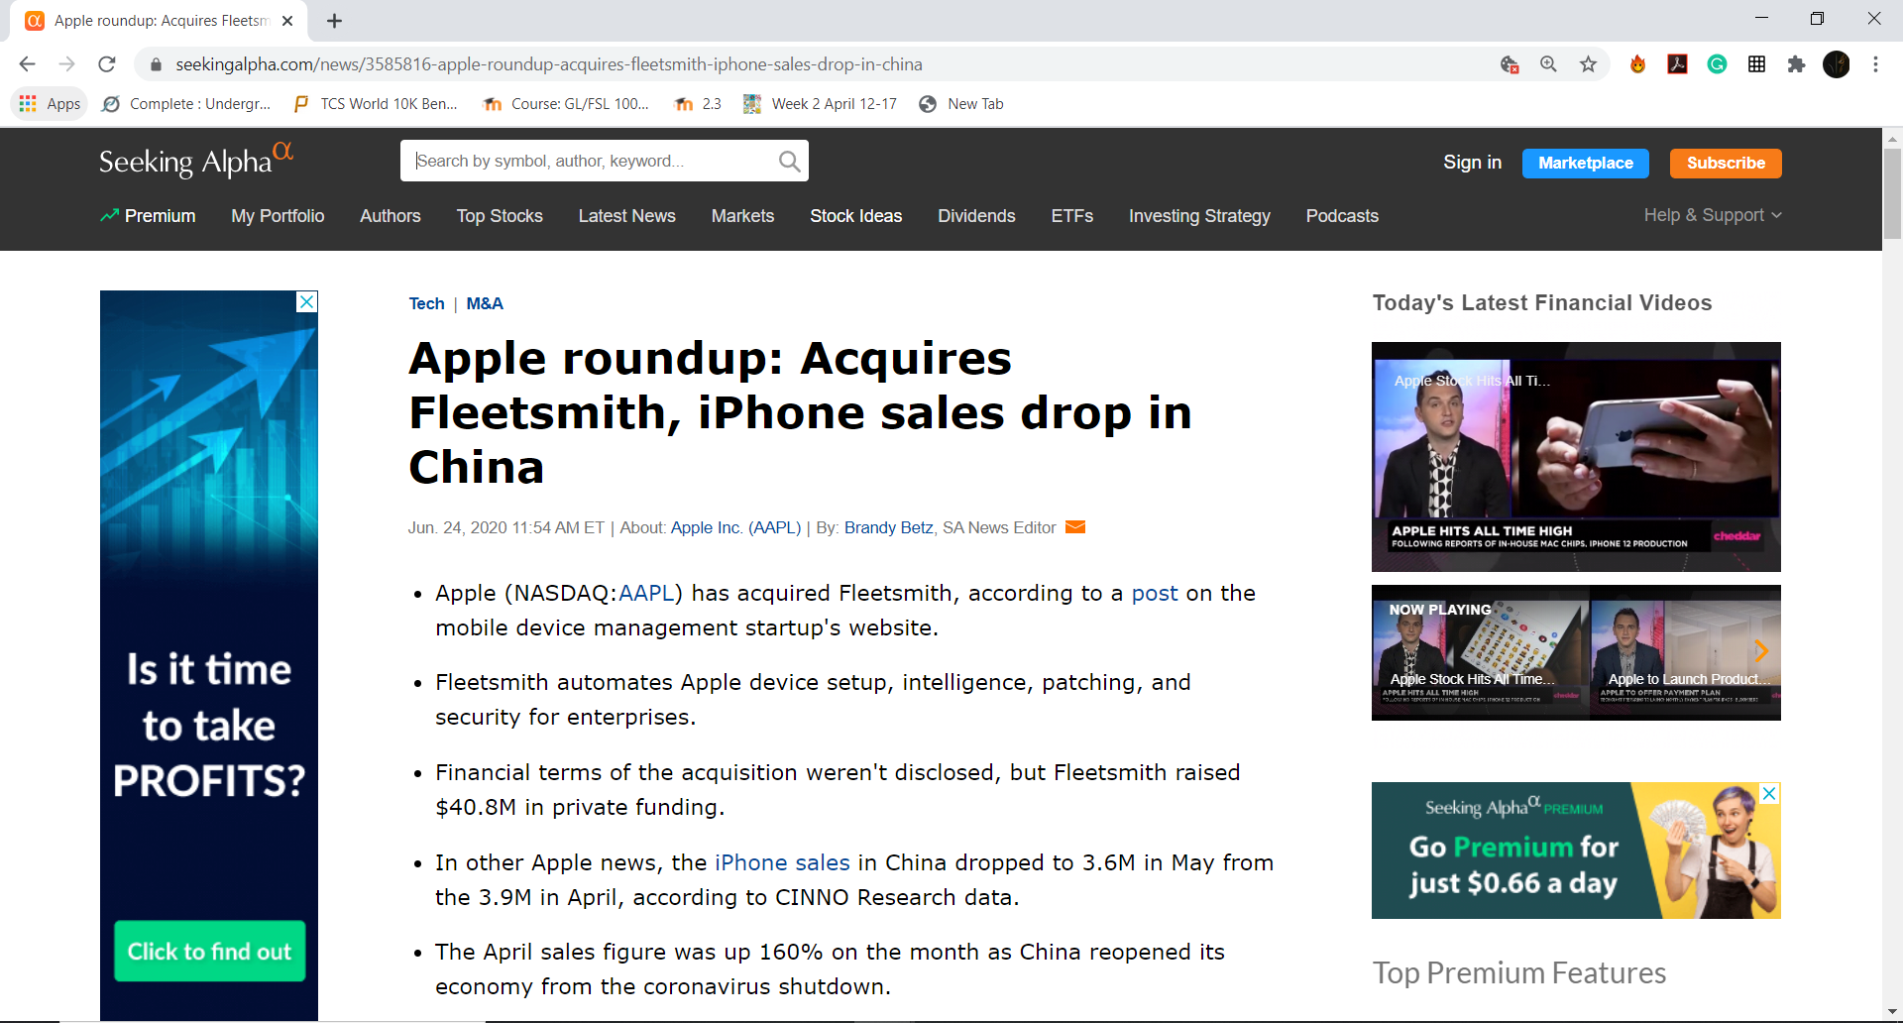
Data Source
Seeking Alpha
Company Articles

Slide 4
Scrapping Logic
Save date, company, author and article text
Scrap all the article links
Iterate through the links

Slide 5
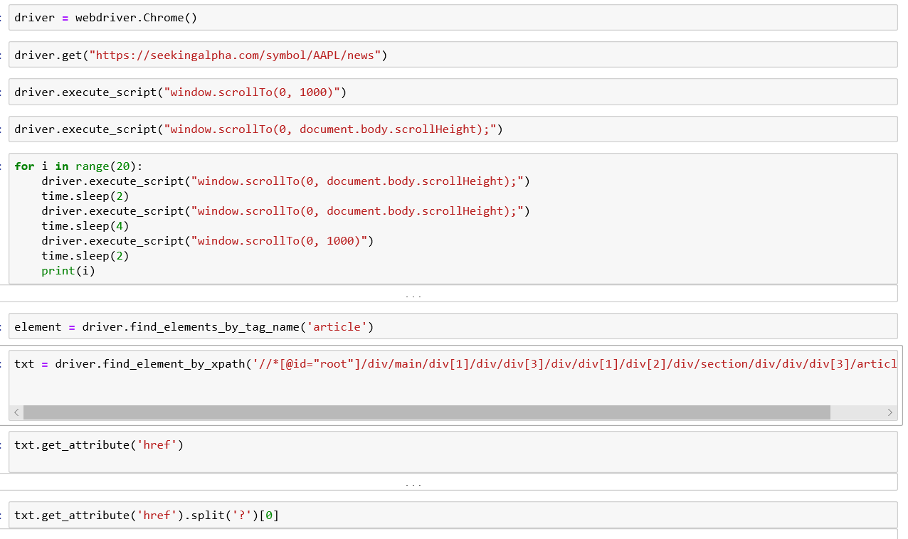
Web Scrapping code

Slide 6
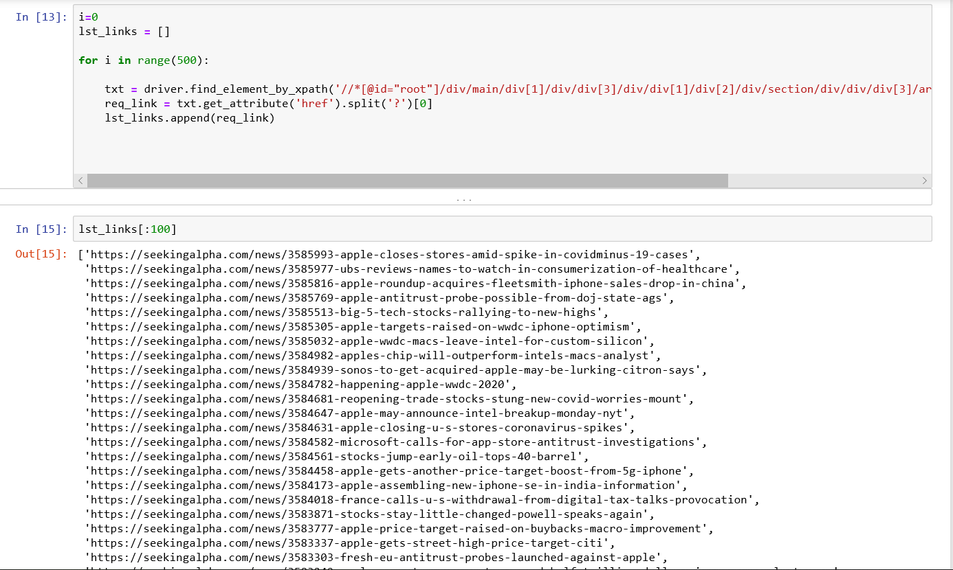
Web Scrapping code

Slide 7
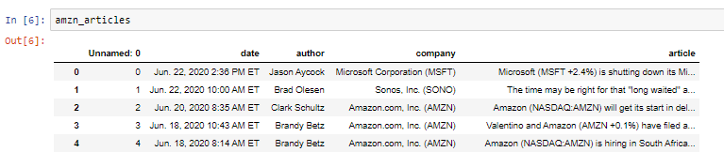
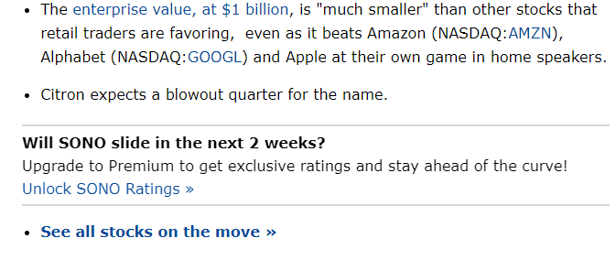
Cleaning & Pre-processing
String date to datetime object
Removing the other company news
Calculating the % change is stock prices
Join articles to stock prices
Ffill prices for the articles published on weekend
Cleaning the text in the articles

Slide 8
Sentiment Analysis
Is Sentiment Analysis helpful?
Mood, opinion and emotion carries immense business value
Helps to improve accuracy and gain better insights
Better understand the motivations behind sentiment
Learn from social posts, news and reviews
Benchmark against competitors
Evaluate campaign impact

Slide 9
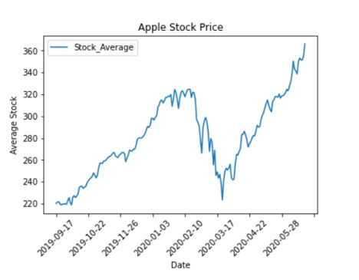
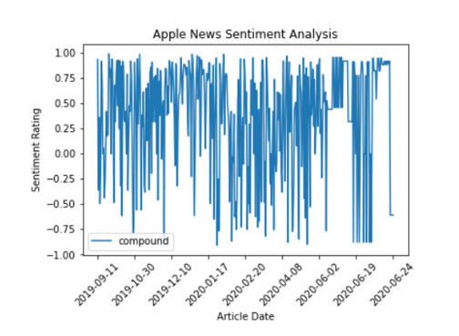
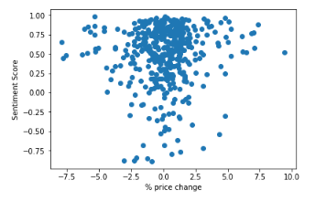
Visualization

Slide 10
Limitations and future steps
ML algorithm
Limited data
Post market news articles
Authors style
Research reports
Limited stopwords
Use of VPN

